Slide 1
Multifactor Authentication
Prepared by:
Edwin Odeimi - 201601044
Walid Aboul Hosn - 201500704
Melissa Abboud - 201401538

Slide 2
Overview
1) Setting up the password
2) Entering the password

Slide 3
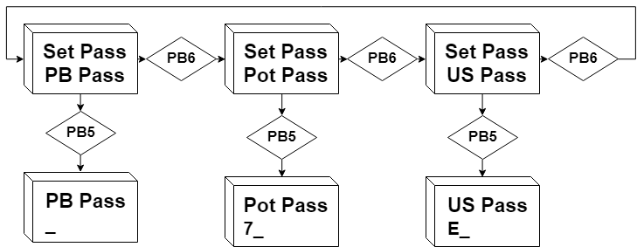
1) Setting up the password
At first launch, the user will be prompted to setup the push buttons order. He can either decide to press PB5 to continue or PB6 to switch to setting up the rest of the password:

Slide 4
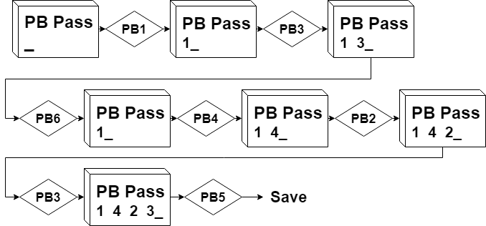
1) Setting up the password
To setup the order of the push buttons, simply press them in the right order.
If you ever need to change the order or undo a false button press, just press PB6:

Slide 5
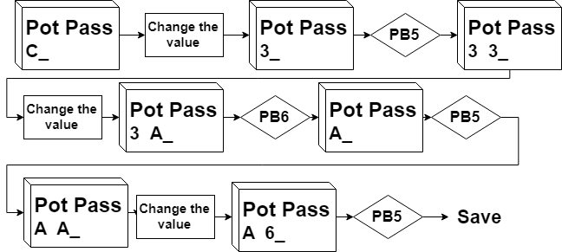
1) Setting up the password
To setup the potentiometer values, simply rotate the potentiometer to the desired value and press PB5.
To delete a value, press PB6:

Slide 6
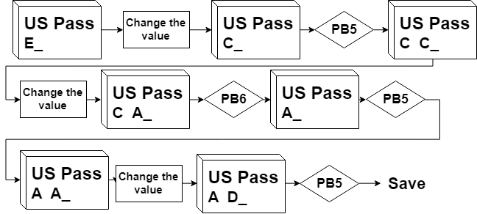
1) Setting up the password
To setup the ultrasonic sensor values, simply position your hand over the sensor at the desired altitude and press PB5.
To delete a value, press PB6:

Slide 7
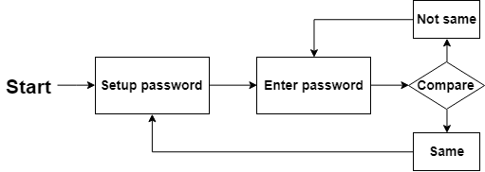
2) Entering the password
To login, the user is supposed to enter the password with the same order and the same values.
The login stage is the same as the password setup stage in terms of functionality:

Slide 8
References
APS12OS User Guide
MC9S12DT256 Device User Guide (MC9S12DT256.pdf)
MC3S12RG128 Data Sheet (Interrupt Registers Reference.pdf)
Axiom Manufacturing: schematic CSMB12D AXM-0436
MC9S12XS256 Reference Manual
CPU 12 Reference Manual

